Slide 1

BANK ANALYTICS
GROUP - 3

Slide 2

MEMBERS:
Jeevan Narra
Manjula A Shinde
Mirza SSV Baig
Rohit Ramesh Kulange
K Rishi Verma
Raksha Y
Arpita D

Slide 3

SUMMARY:
Banking analytics is the process of collecting, analyzing, and interpreting data within the banking industry. By extracting valuable information from various sources, such as customer transactions, market trends, risk assessments, and operational performance, financial institutions can gain valuable insights and make informed decisions. Banking analytics requires the use of various analytical techniques and technologies including data visualization, business intelligence, AI-assisted data modeling, data mining, real-time KPI monitoring, and big data platforms.
Banking analytics is important because it enables banks, credit unions, and other financial institutions to turn the massive quantities of data they create or consume into valuable, actionable insights. Data analytics in banking is a powerful tool for improving performance, optimizing the customer experience, and growing revenue, amongst other things.
Banking analytics are of many types
Descriptive analytics, Diagnostic analytics, Predictive analytics, Prescriptive analytics, Real-time analytics, Behavioral
Analytics, Risk analytics.
Benefits of Banking analytics are Enhanced customer insights,Improved risk management, Optimized operations, Data-driven decision making, Competitive advantage.

Slide 4
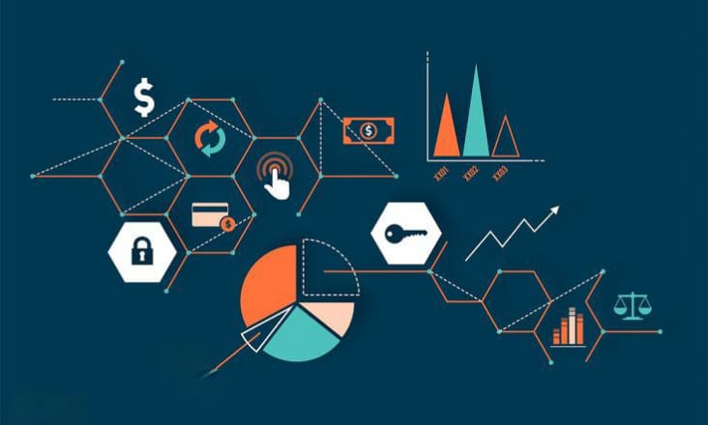
KPI’S:
Year Wise Loan Amount
Grade And Sub Grade Wise Revol Balance
Verified And Non Verified Status For Total Payment
State Wise And Month Wise Loan Status
Home Ownership Vs Last Pay
Term Wise Sum Of Installments
Top 10 Funded Amount Investors
Annual Income Wise Grade And Title Of Employee
Purpose Wise Sum Of Loan Amount And Count Of Loan Amount
Sum Of Recoveries Wise Of An Open Account

Slide 5
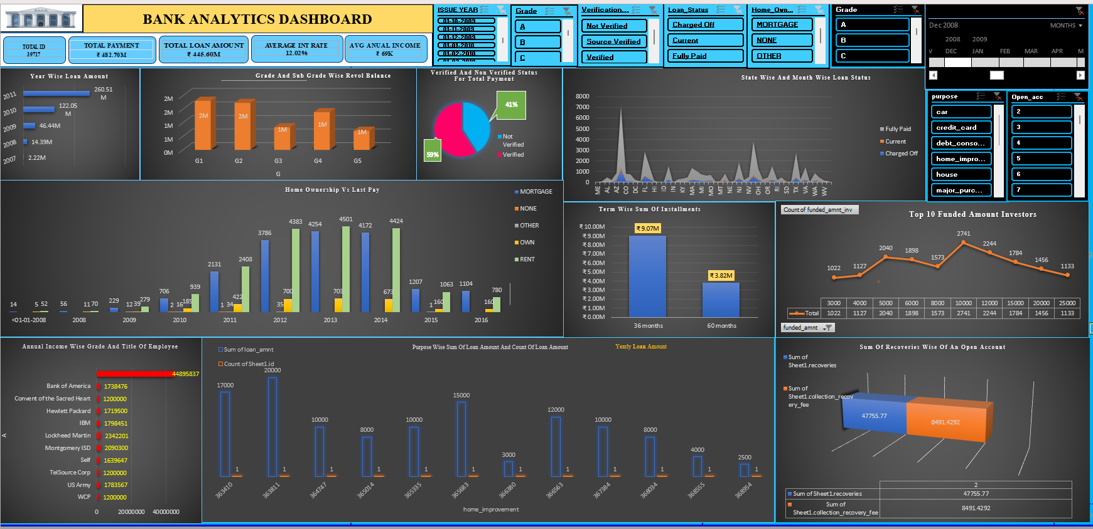
BANK ANALYTICS EXCEL DASHBOARD

Slide 6
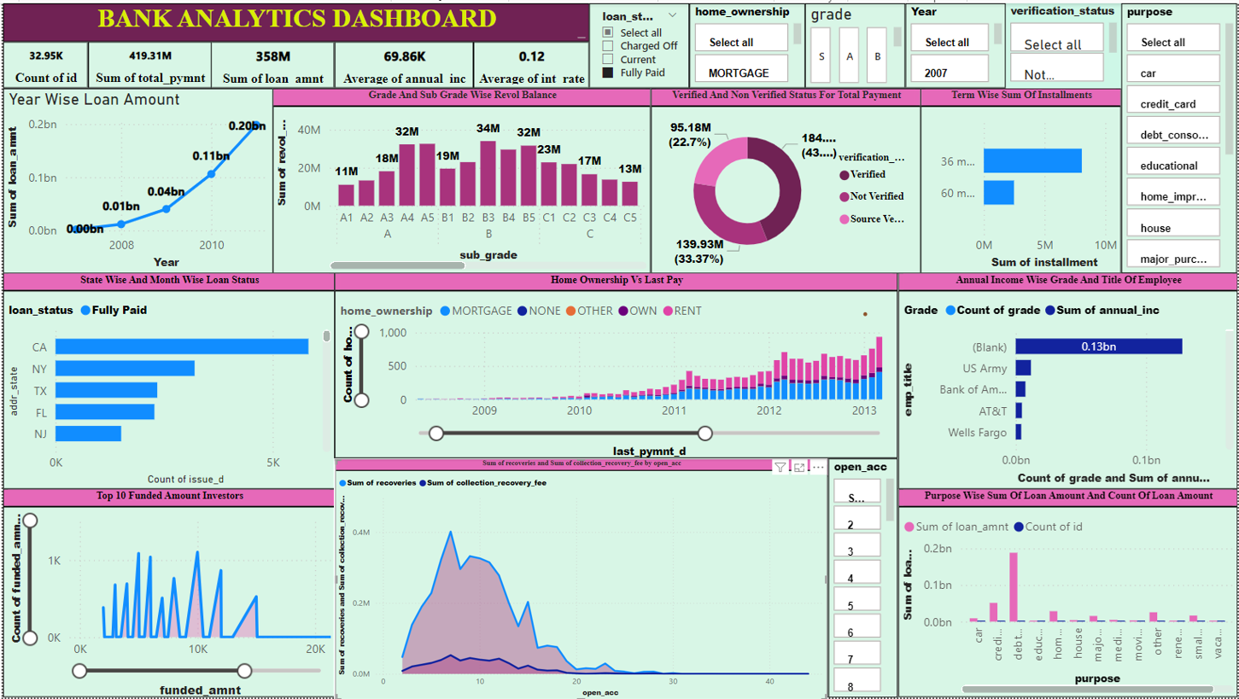
BANK ANALYTICS POWER BI BIDASHBOARD

Slide 7
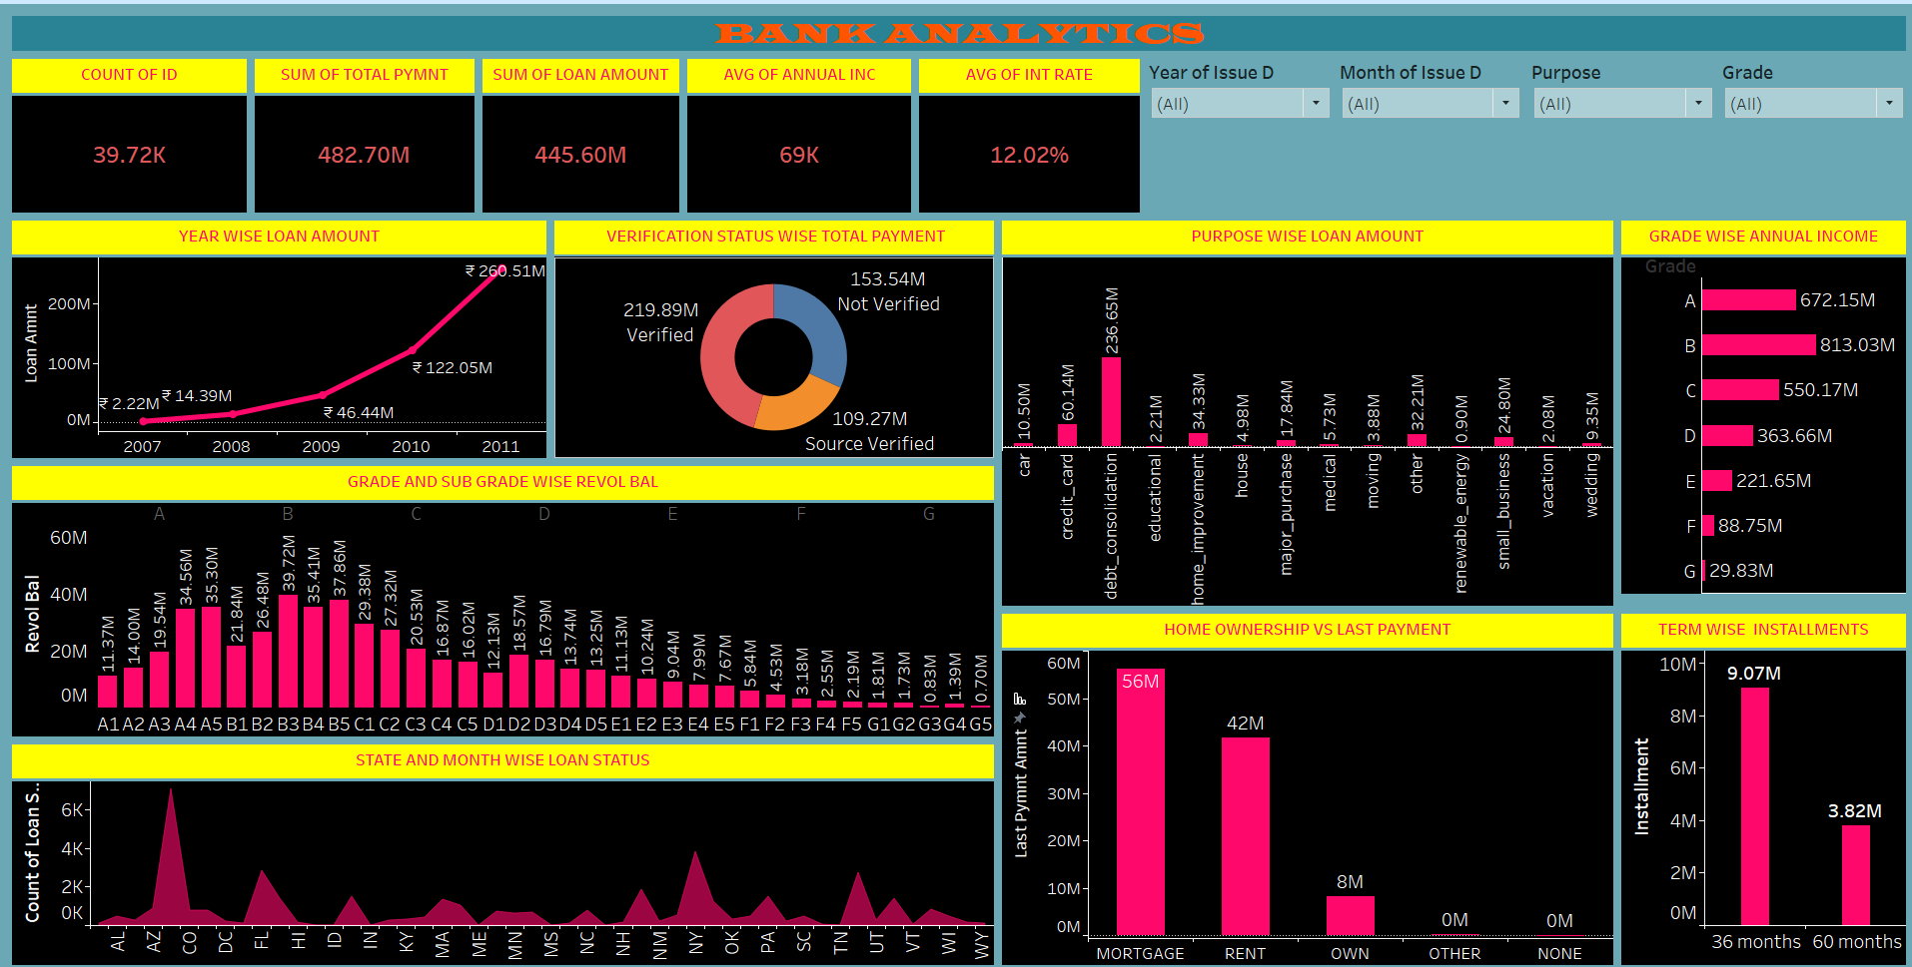
BANK ANALYTICS TABLEAU DASHBOARD

Slide 8
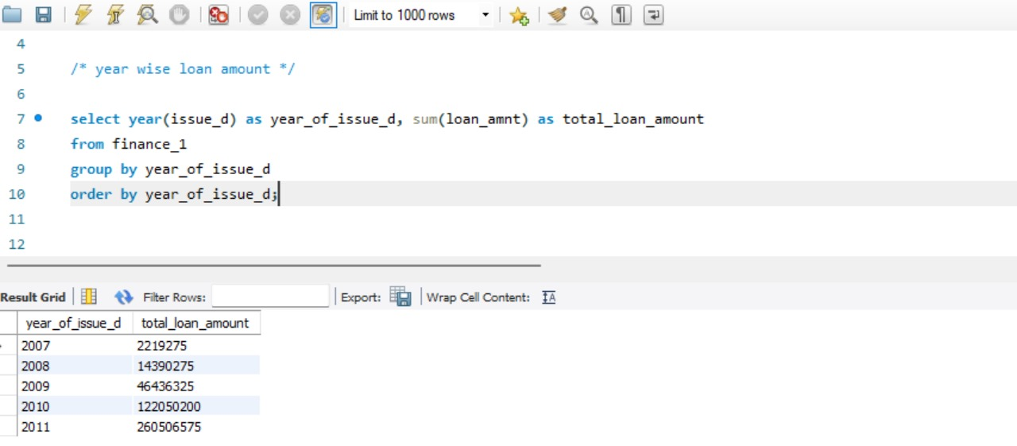
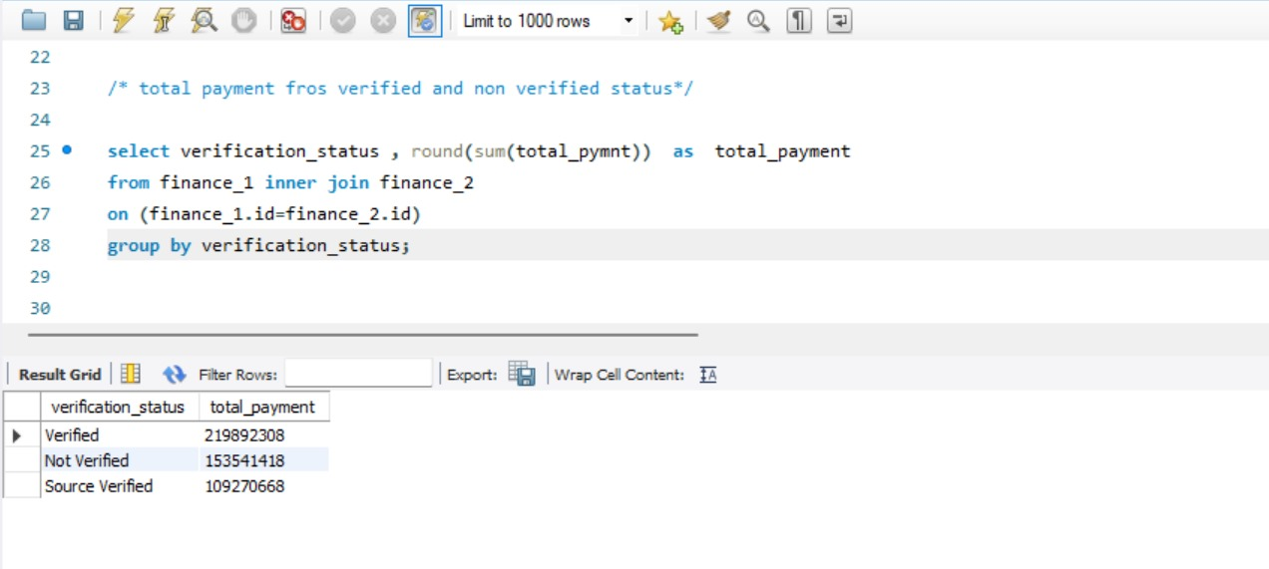
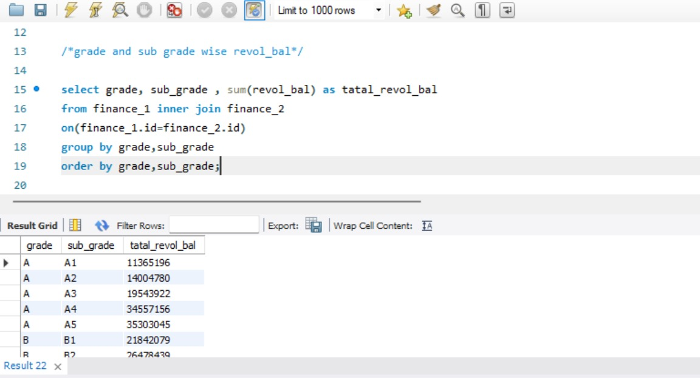
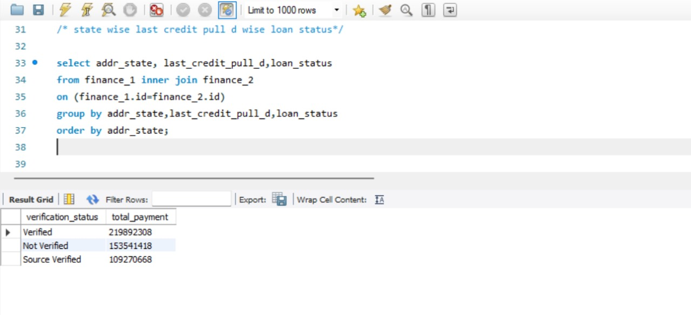
SQL COMMANDS

Slide 9
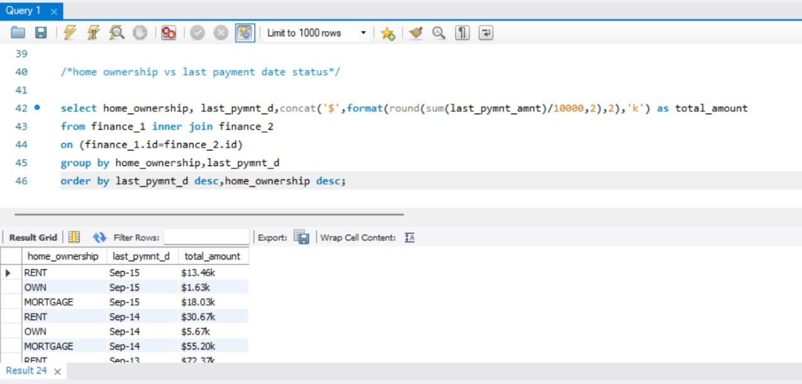
SQL COMMANDS

Slide 10
KEY TAKE AWAYS:
Bank analytics provides banks with actionable insights to improve decision-making, customer service, risk management, and operational efficiency. By leveraging data, banks can stay competitive and responsive to changing financial landscapes and customer expectations.
Customer Insights
Risk Management
Operational Efficiency
Fraud Detection & Prevention
Marketing & Product Development
Regulatory Compliance
Financial Forecasting
Customer Retention and Lifetime Value
Loan Analytics

Slide 11
THANK YOU !!

